Slide 1
Automated License plate Recognition Automated License Plate Recognition (ALPR) is a technology widely used for traffic management, security, and law enforcement. This project implements ALPR using the “You Only Look Once” (YOLO) object detection algorithm, which is renowned for its real-time speed and high accuracy. The system consists of three main stages: license plate detection, character segmentation, and optical character recognition (OCR). YOLO is used in the first stage to detect and localize license plates within video frames or images. YOLO’s deep learning architecture, which processes images in a single neural network pass, ensures efficient and accurate plate detection even under challenging conditions like varying lighting, occlusions, or angled views.
Arup Chakraborty

Slide 2
Abstract/Overview
Aim:
AI system
Automatically Detect the license plate for vehicles
Additional Goals
Accurate License plate detection
Precise character recognition for license plate
Real-time processing for traffic monitoring, automated toll collection, security surveillances.
Comprehensive evaluation of metrics via Tensorboard

Slide 3
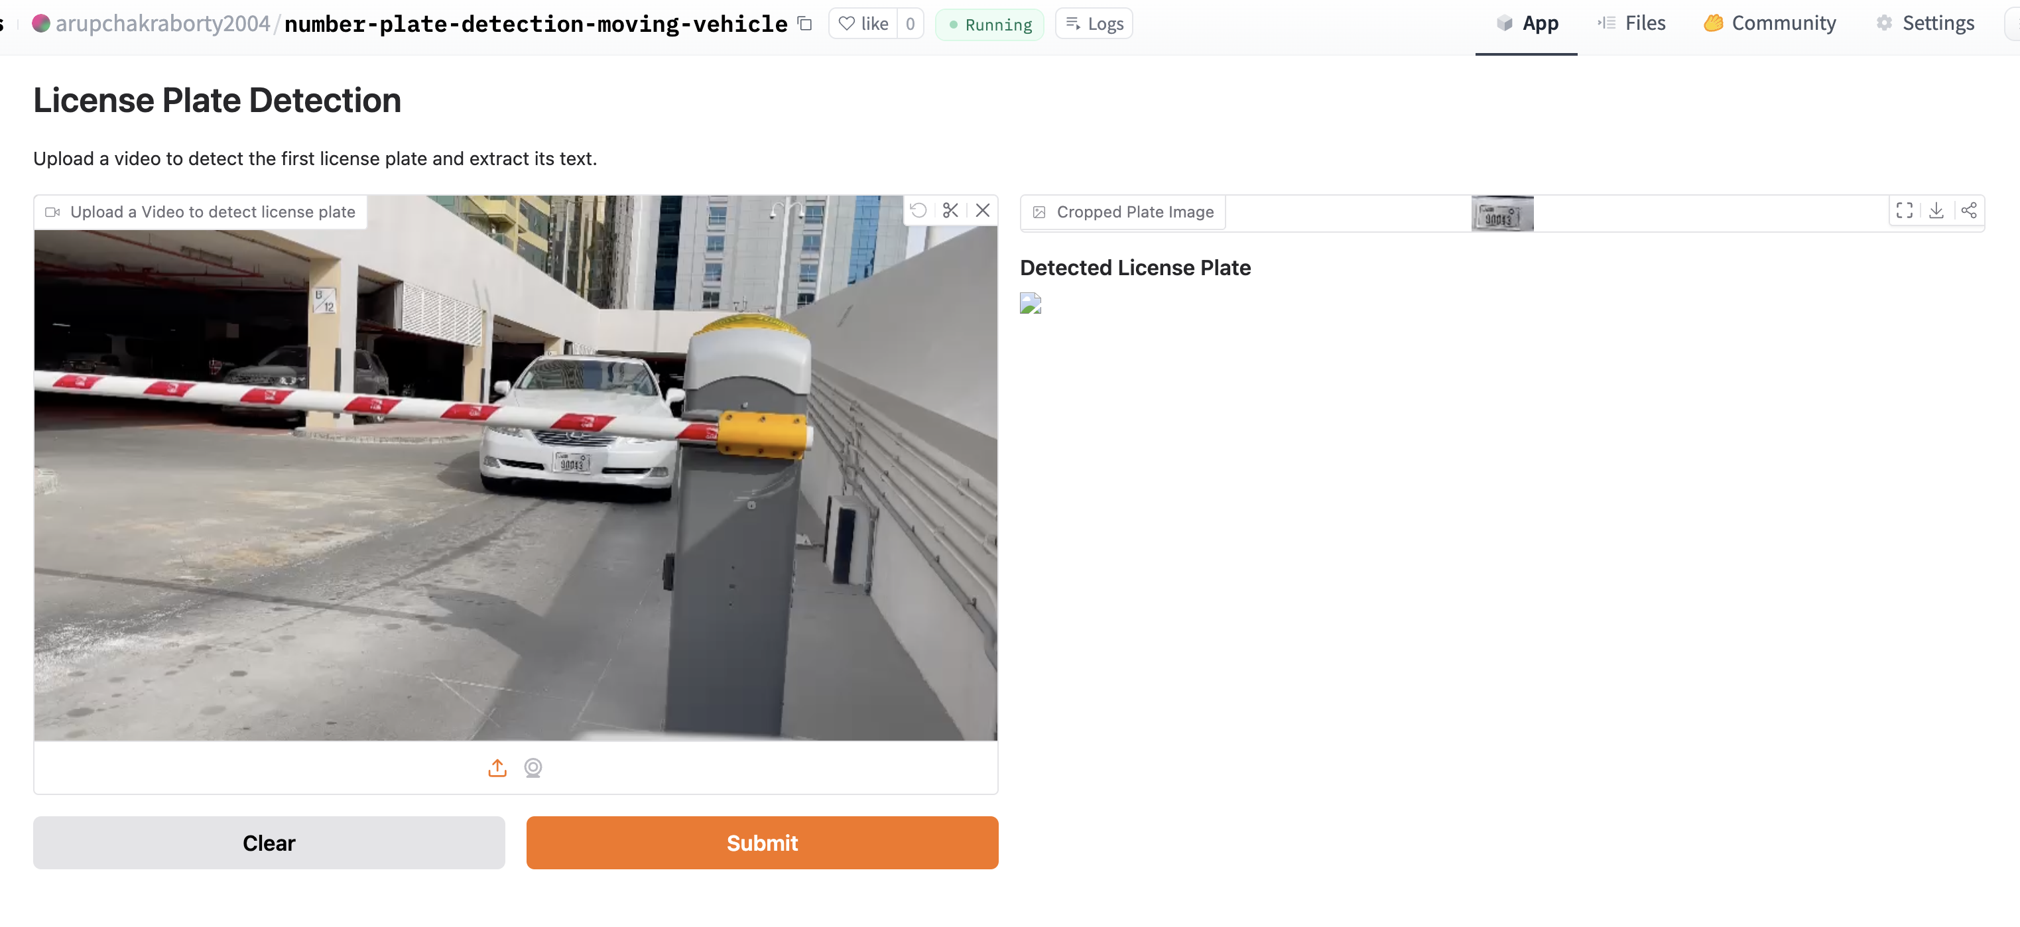
Demo with real-time dataset
https://huggingface.co/spaces/arupchakraborty2004/number-plate-detection-moving-vehicle

Slide 4
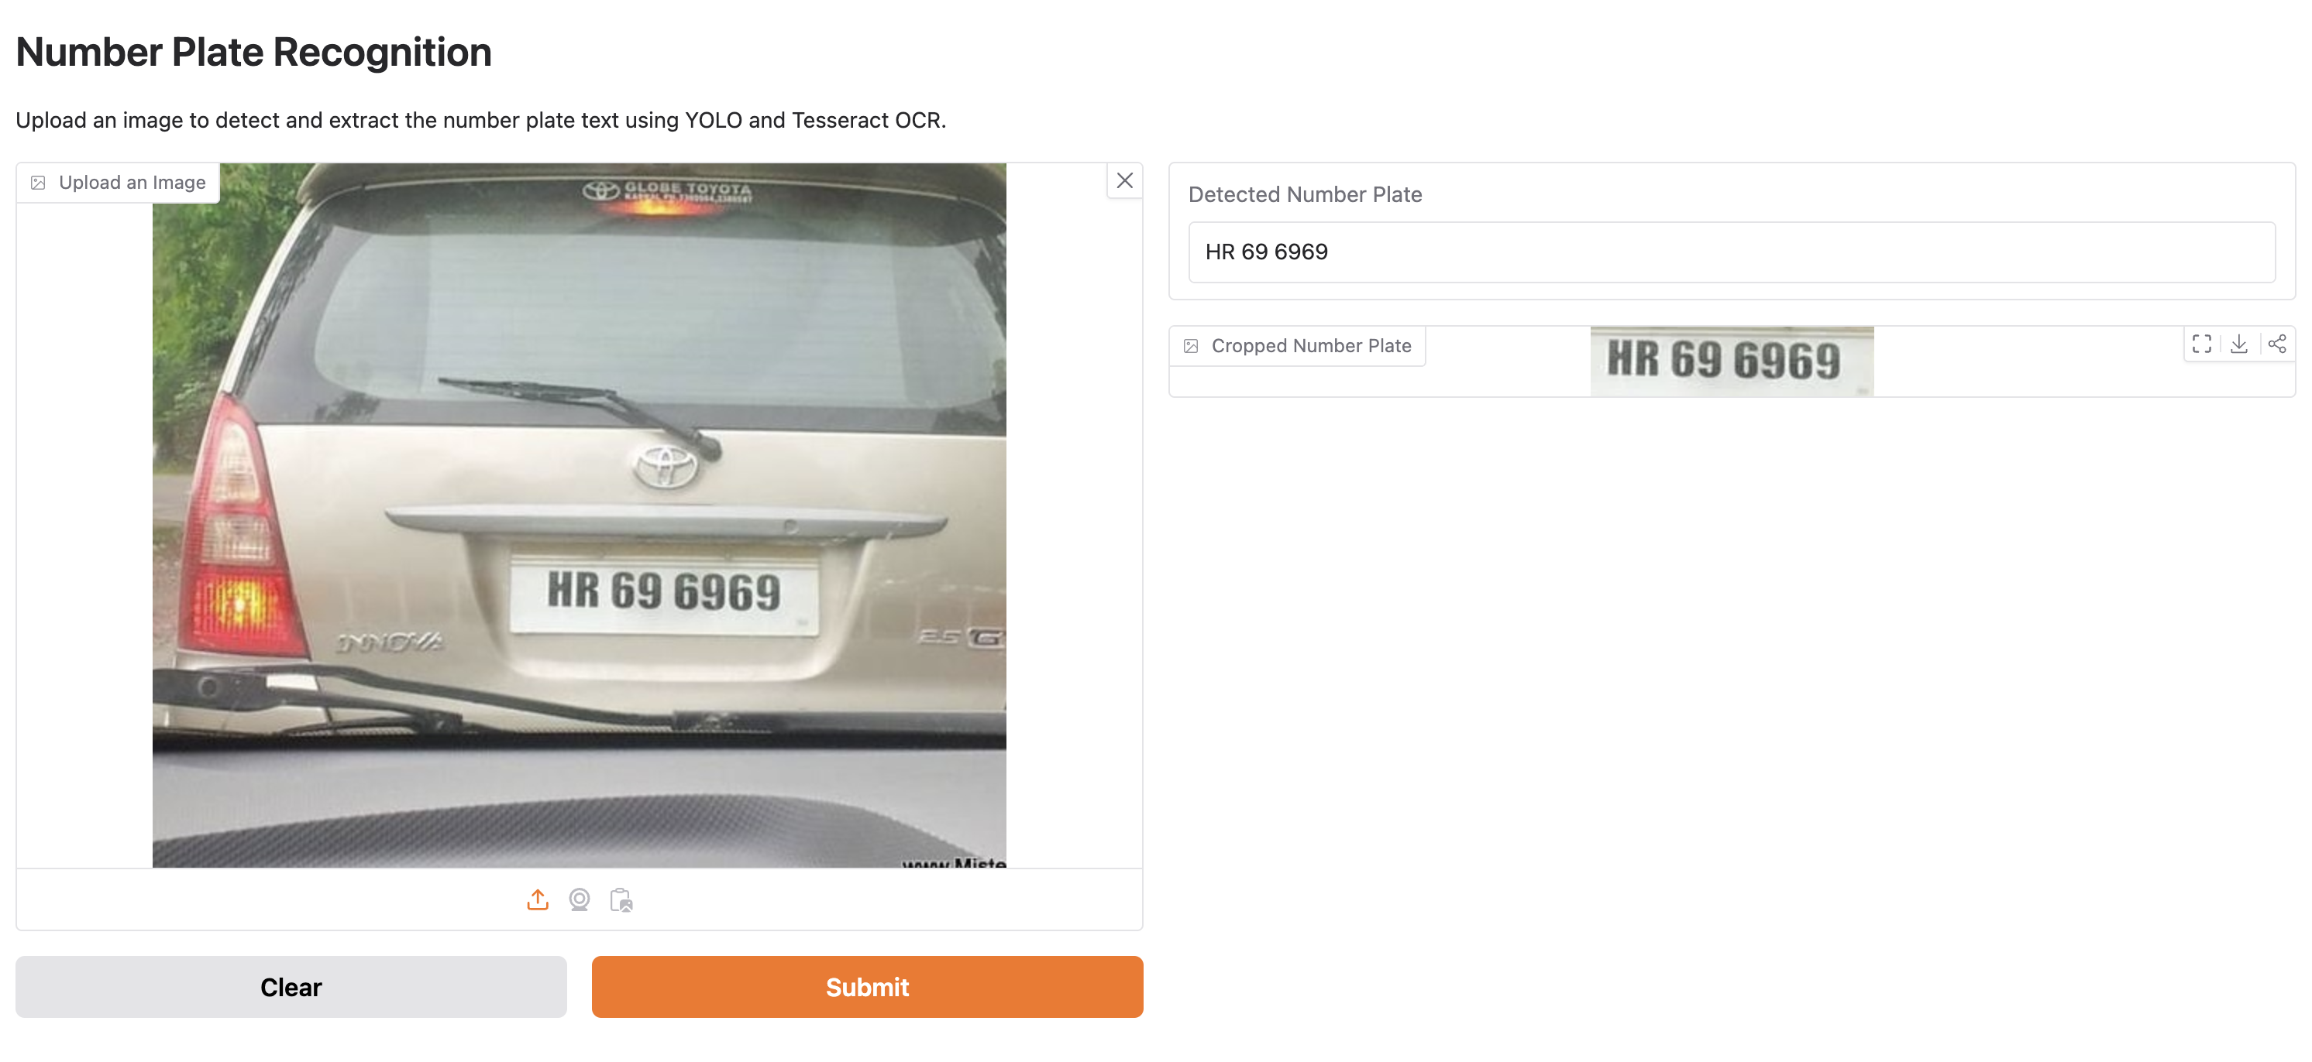
Demo with real-time dataset
https://huggingface.co/spaces/arupchakraborty2004/image-recognition-yolo

Slide 5
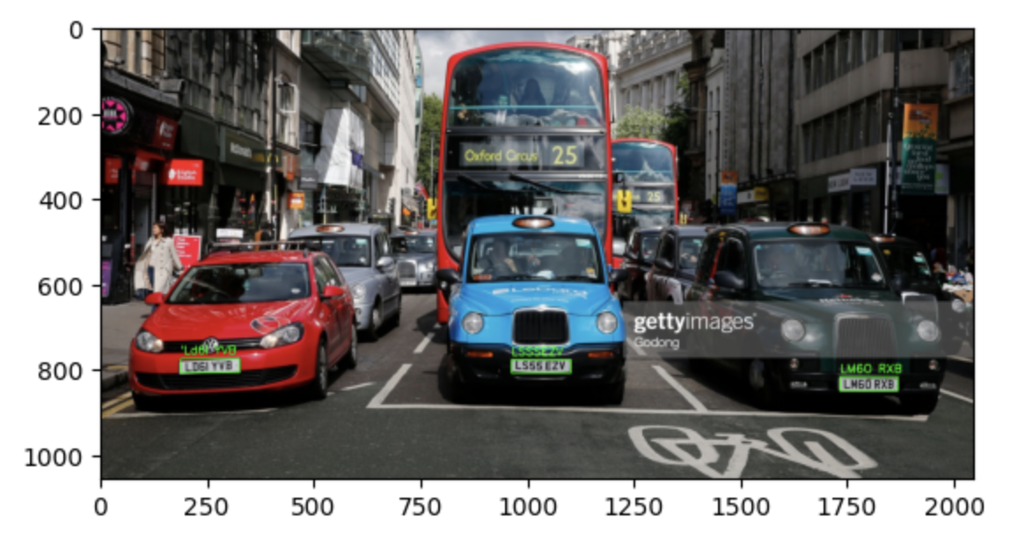
Demo with real-time dataset
License plates recognition for cars from a traffic signal

Slide 6
Abstract/Overview
Code attempts to
Reduce detection time for license plates from images and videos
Improve accuracy
Support decision-making for traffic management, law enforcement, automated toll system.
Focus issues
Data quality and augmentation
Model Accuracy
Balancing sensitivity and decision making
Interpretability of results and metrics
Model hosting

Slide 7
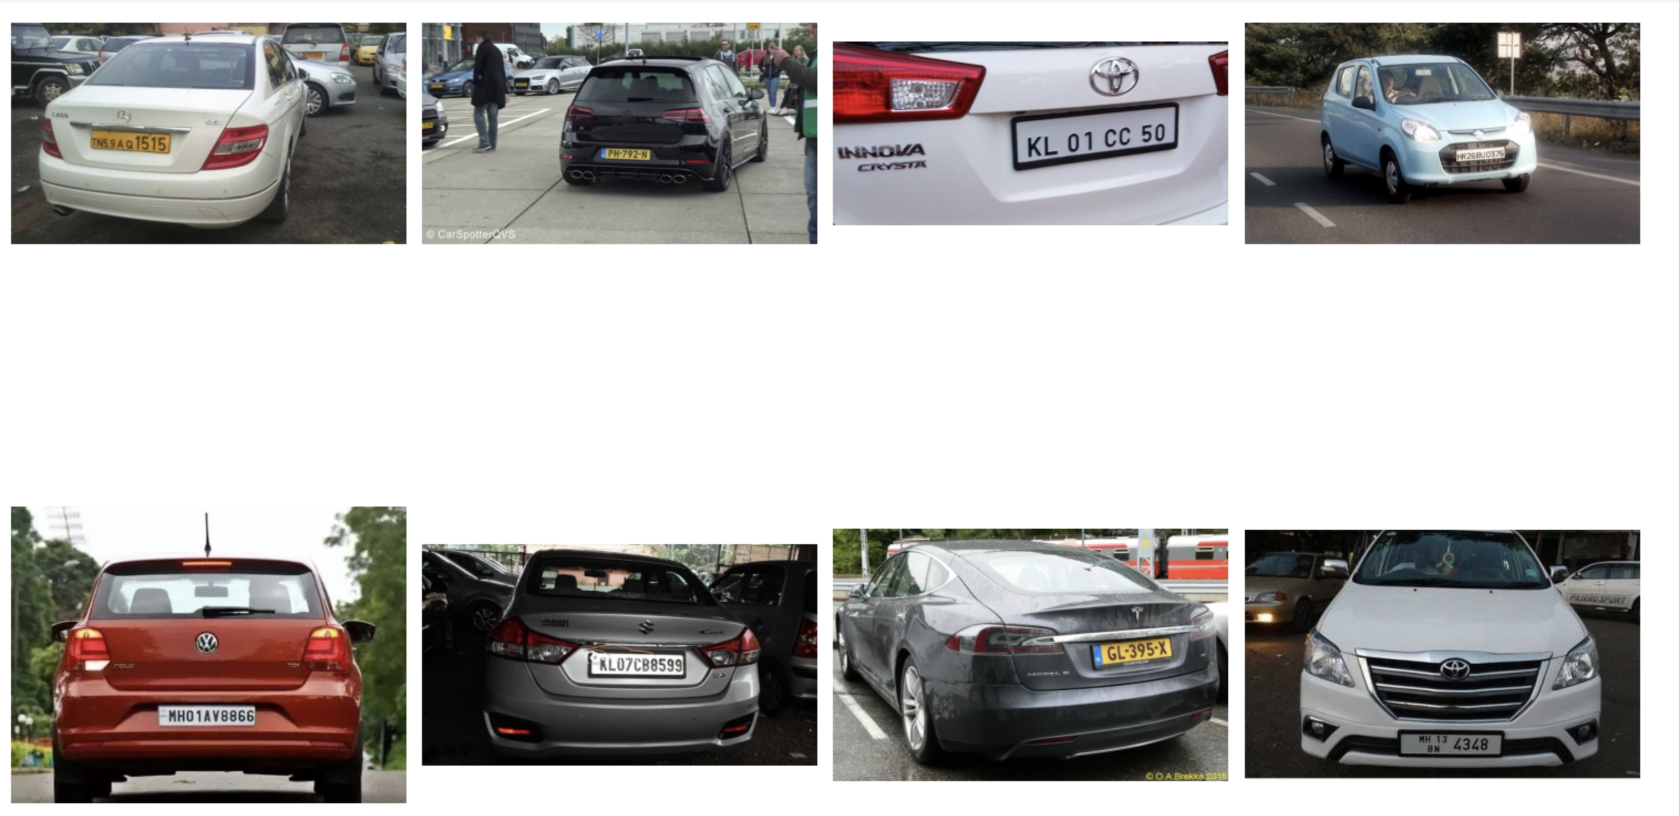
Overview of Dataset
Dataset composition
Images
Annotations
Classes
Variations
Features and attributes

Slide 8
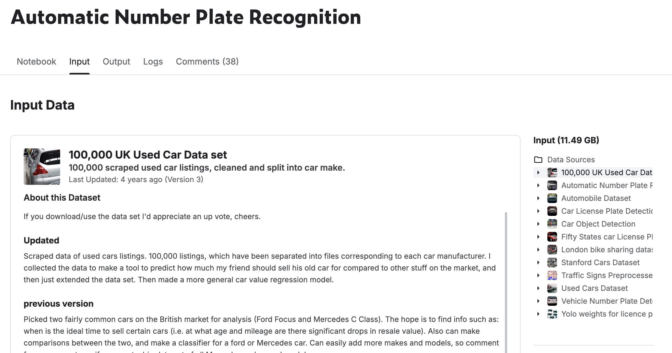
Methods - Creating a Model to Detect License plates
Data Selection
Data Acquisition and Preparation
Data Exploration and Preprocessing
Model Development using YOLO, RESNET
Notes:
Arup starts

Slide 9
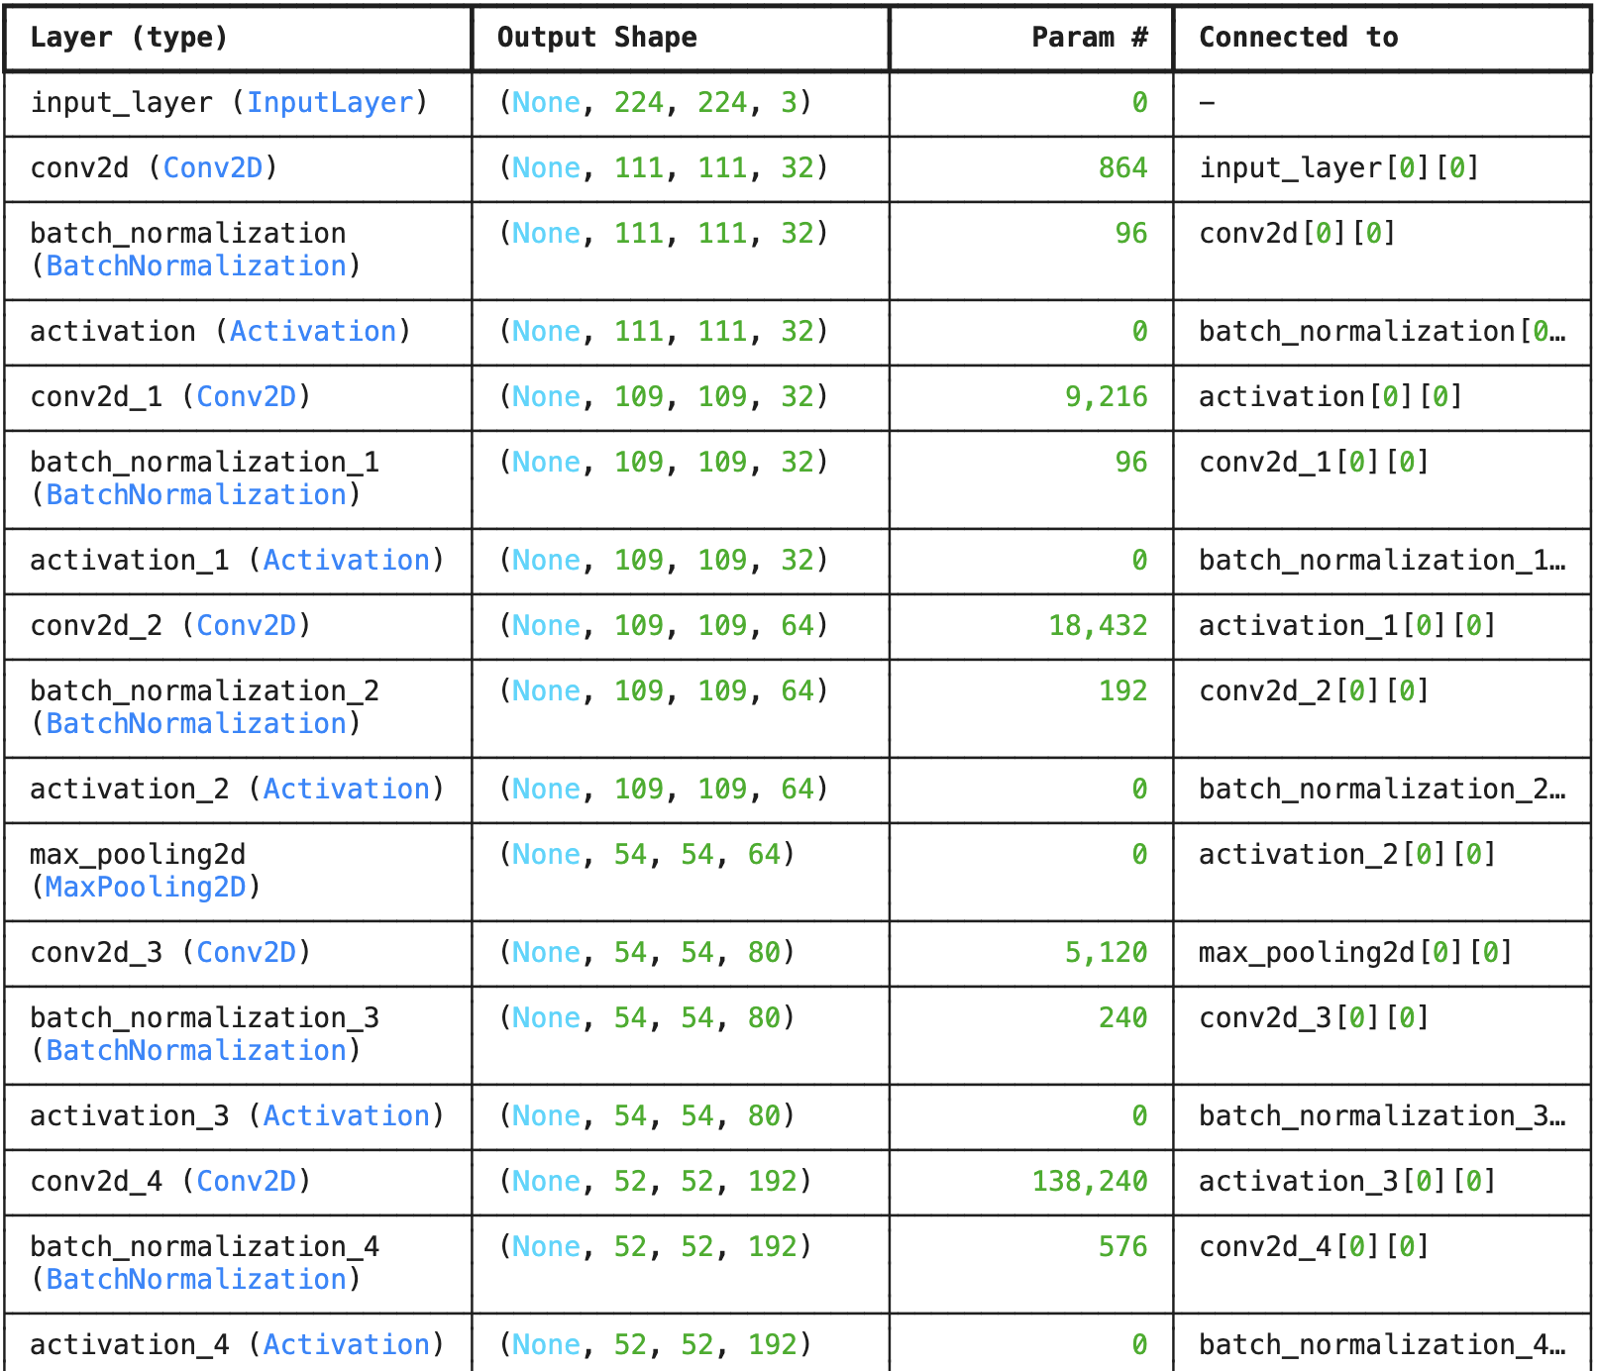
Methods - Training Model and Evaluation
Training and Validation Setup
Model Training and Visualization
Model Architecture and Compilation
Model Performance Evaluation
Model Evaluation Metrics

Slide 10
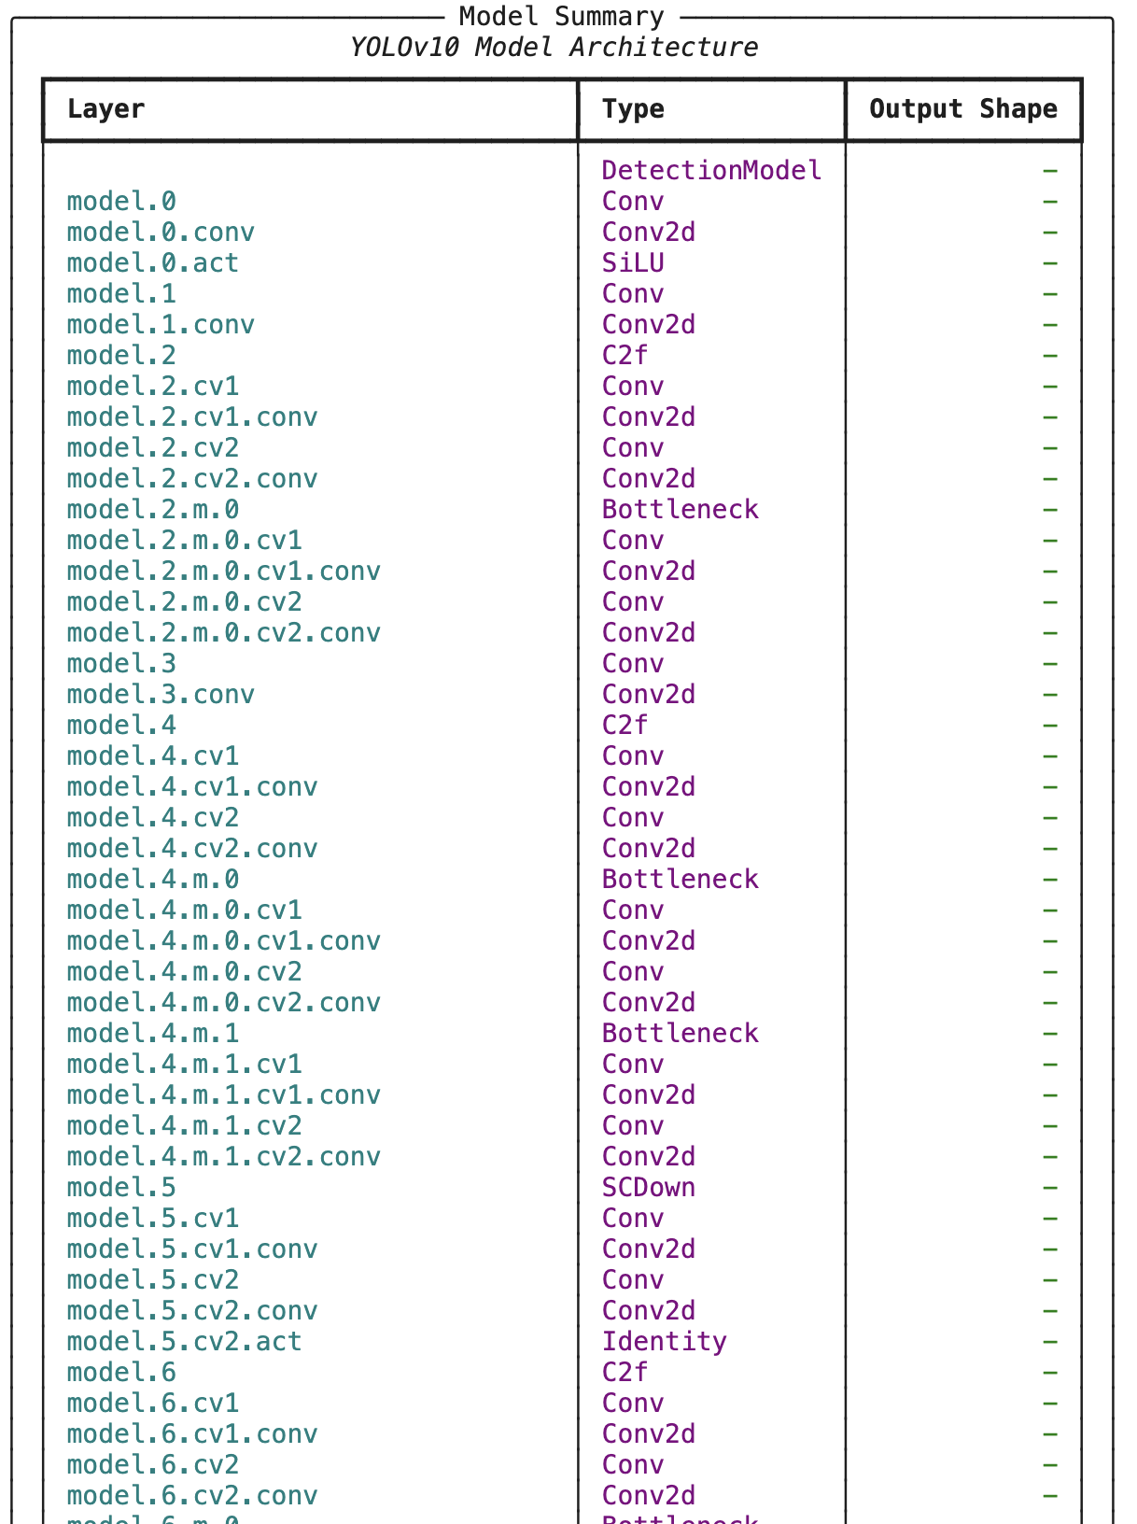
Methods - Training Model and Evaluation
Training and Validation Setup
Model Training and Visualization
Model Architecture and Compilation
Model Performance Evaluation
Model Evaluation Metrics

Slide 11
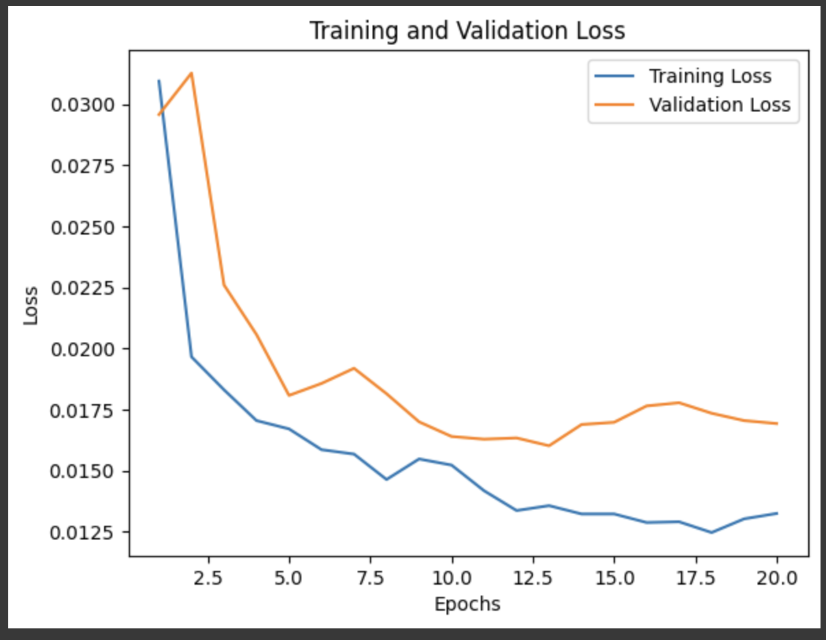
Results/Discussion - Model Performance Evaluation
Model training and validation loss
Model monitoring via Tensorboard
Efficient learning
No overfitting
Transfer learning

Slide 12
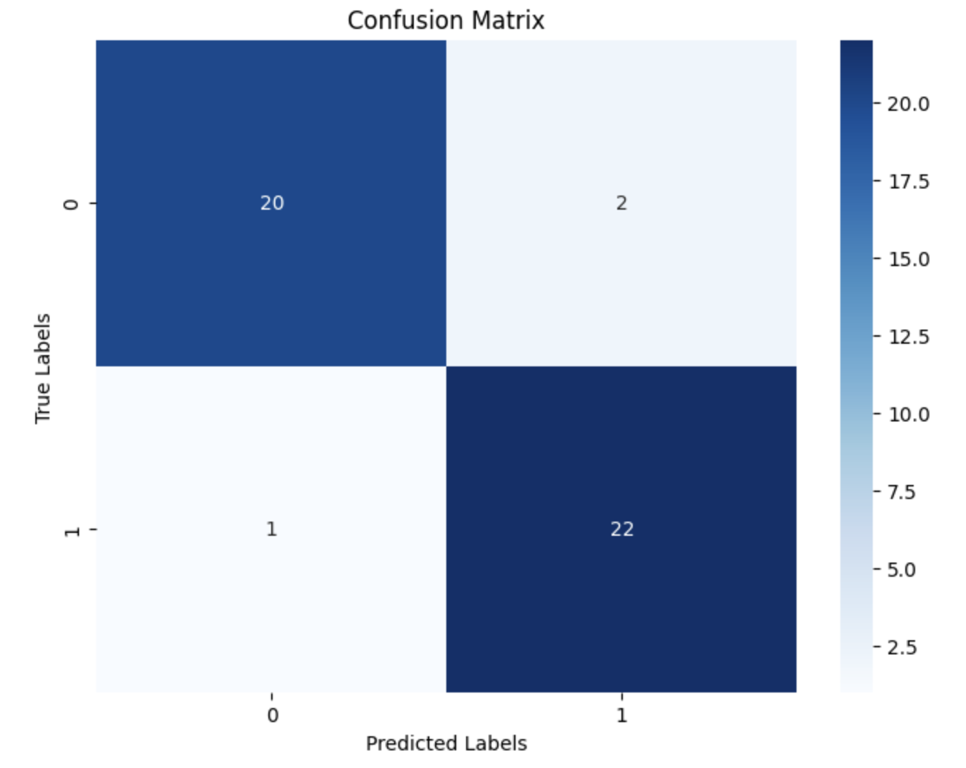
Results/Discussion - Model Evaluation Metrics
Confusion Matrix
Comprehensive insights
Advantages
Disadvantages
Compare with other models

Slide 13
Observations
Model accuracy depends on
Data Quality and Quantity
More data
Data augmentation
Balanced dataset
Model Architecture
Depth of network
Hyperparameter tuning
Regularization Techniques
Dropout
Weight regulation
Notes:
The accuracy for model predictions depends on quite a few factors:
Data Quality and Quantity
More Data: Generally, more data leads to better model performance.
Data Augmentation: Techniques like rotation, scaling, cropping, and flipping can help the model generalize better by providing a more diverse set of training examples.
Balanced Dataset: We need to prevent the model from becoming biased toward more frequent classes.
Model Architecture
Depth of the Network: Adding more layers can help the model learn more complex patterns, but too many layers might lead to overfitting.
Hyperparameter Tuning: Optimizing hyperparameters, including the number of filters, kernel size, and activation functions, can significantly impact model performance.
Regularization Techniques
Dropout: Randomly dropping units from the neural network during training can prevent overfitting.
Weight Regularization: Adding L1 or L2 regularization to the model weights can also help prevent overfitting by penalizing large weights.

Slide 14
Discussion Continued
Future Enhancements
Advanced YOLO model, like YOLOv11
Multilingual support for international license plates
Dataset enhancements
Improved OCR technologies
Enhanced security for detecting fake license plates
Traffic Management:
- Multi-lane detection and real-time processing for self driving cars
Security Applications:
- Night vision and anomaly detection.
Toll Automation and Parking:
- Integration with payment systems.

Slide 15
References
Bochkovskiy, A., Wang, C. Y., & Liao, H. Y. M. (2020). YOLOv4: Optimal speed and accuracy of object detection. arXiv preprint arXiv:2004.10934. Retrieved from https://arxiv.org/abs/2004.10934
Redmon, J., & Farhadi, A. (2018). YOLOv3: An incremental improvement. arXiv preprint arXiv:1804.02767. Retrieved from https://arxiv.org/abs/1804.02767
Tesseract OCR. (2023). Tesseract Open Source OCR Engine. Retrieved from https://github.com/tesseract-ocr/tesseract
Goodfellow, I., Bengio, Y., & Courville, A. (2016). Deep learning. MIT Press.
Ultralytics. (2024). YOLOv8 Documentation. Retrieved from https://docs.ultralytics.com
Kingma, D. P., & Ba, J. (2015). Adam: A method for stochastic optimization. arXiv preprint arXiv:1412.6980. Retrieved from https://arxiv.org/abs/1412.6980
Ronneberger, O., Fischer, P., & Brox, T. (2015). U-Net: Convolutional networks for biomedical image segmentation. In International Conference on Medical Image Computing and Computer-Assisted Intervention (pp. 234–241). Springer, Cham.
Ahmedov, A. (n.d.). Automatic number plate recognition [Kaggle Notebook]. Retrieved from https://www.kaggle.com/code/aslanahmedov/automatic-number-plate-recognition/input

Slide 16
Thank you!
Notes:
On behalf of Team 11s, thank you for your time watching my presentation.

